Slide 1
Guest Lecture for ECE 573
Performance Evaluation
Yifeng Zhu
Fall, 2009
Lecture notes based in part on slides created by John Shen, Mark Hill, David Wood, Guri Sohi, Jim Smith, Lizy Kurian John, and David Lilja

Slide 2
Performance Evaluation
Evaluating Computer Systems
Evaluating Microprocessors
Computer Architecture – Design Choices
Architectural Enhancements
How to tell whether an enhancement is worthwhile or not

Slide 3
Performance and Cost
Which computer is fastest?
Not so simple
  Scientific simulation – FP performance and I/O
  Program development – Integer performance
  Commercial workload – Memory, I/O

Slide 4
Performance of Computers
Want to buy the fastest computer for what you want to do?
  Workload is all-important
  Correct measurement and analysis
Want to design the fastest computer for what the customer wants to pay?
  Cost is always an important criterion

Slide 5
Response Time vs. Throughput
Is throughput = 1/av. response time?
  Only if NO overlap
  Otherwise, throughput > 1/av. response time

Slide 6
Iron Law
Time
Processor Performance = ---------------
Program
=
Instructions
Cycles
Time
X
X
Program
Instruction
Cycle
(code size)
(CPI)
(cycle time)
Architecture --> Implementation --> Realization
Compiler Designer Processor Designer Chip Designer

Slide 7
Our Goal
Minimize time which is the product, NOT isolated terms
Common error to miss terms while devising optimizations
  E.g. ISA change to decrease instruction count
  BUT leads to CPU organization which makes clock slower
Bottom line: terms are inter-related

Slide 8
Other Metrics
MIPS and MFLOPS
MIPS = instruction count/(execution time x 10⁶)
  = clock rate/(CPI x 10⁶)
But MIPS has serious shortcomings

Slide 9
Problems with MIPS
E.g. without FP hardware, an FP op may take 50 single-cycle instructions
With FP hardware, only one 2-cycle instruction
Thus, adding FP hardware:
  CPI increases (why?)
  Instructions/program decreases (why?)
  Total execution time decreases
BUT, MIPS gets worse!

Slide 10
Problems with MIPS
Ignore program
Usually used to quote peak performance
  Ideal conditions => guarantee not to exceed!
When is MIPS ok?
  Same compiler, same ISA
  E.g. same binary running on Pentium-III, IV
  Why? Instr/program is constant and can be ignored

Slide 11
Other Metrics
MFLOPS = FP ops in program/(execution time x 10⁶)
Assuming FP ops independent of compiler and ISA
  Often safe for numeric codes: matrix size determines # of FP ops/program
  However, not always safe:
    Missing instructions (e.g. FP divide, sqrt/sin/cos)
    Optimizing compilers
Relative MIPS and normalized MFLOPS
  Normalized to some common baseline machine
    E.g. VAX MIPS in the 1980s

Slide 12
Rules
Use ONLY Time
Beware when reading, especially if details are omitted
Beware of Peak
  Guaranteed not to exceed

Slide 13
Iron Law Example
Machine A: clock 1ns, CPI 2.0, for program x
Machine B: clock 2ns, CPI 1.2, for program x
Which is faster and how much?
  Time/Program = instr/program x cycles/instr x sec/cycle
  Time(A) = N x 2.0 x 1 = 2N
  Time(B) = N x 1.2 x 2 = 2.4N
  Compare: Time(B)/Time(A) = 2.4N/2N = 1.2
So, Machine A is 20% faster than Machine B for this program

Slide 14
Which Programs
Execution time of what program?
Best case – you always run the same set of programs
  Port them and time the whole workload
In reality, use benchmarks
  Programs chosen to measure performance
  Predict performance of actual workload
  Saves effort and money
  Representative? Honest? Benchmarketing…

Slide 15
Types of Benchmarks
Real programs
  representative of real workload
  only accurate way to characterize performance
  requires considerable work
Kernels or microbenchmarks
  “representative” program fragments
  good for focusing on individual features not big picture
Instruction mixes
  instruction frequency of occurrence; calculate CPI

Slide 16
Benchmarks: SPEC2k & 2006
System Performance Evaluation Cooperative
  Formed in 80s to combat benchmarketing
  SPEC89, SPEC92, SPEC95, SPEC2k, now SPEC2006
12 integer and 14 floating-point programs
  Sun Ultra-5 300MHz reference machine has score of 100
  Report GM of ratios to reference machine

Slide 17
Benchmarks: SPEC CINT2000
Benchmark | Description
164.gzip | Compression
175.vpr | FPGA place and route
176.gcc | C compiler
181.mcf | Combinatorial optimization
186.crafty | Chess
197.parser | Word processing, grammatical analysis
252.eon | Visualization (ray tracing)
253.perlbmk | PERL script execution
254.gap | Group theory interpreter
255.vortex | Object-oriented database
256.bzip2 | Compression
300.twolf | Place and route simulator

Slide 18
Benchmarks: SPEC CFP2000
Benchmark | Description
168.wupwise | Physics/Quantum Chromodynamics
171.swim | Shallow water modeling
172.mgrid | Multi-grid solver: 3D potential field
173.applu | Parabolic/elliptic PDE
177.mesa | 3-D graphics library
178.galgel | Computational Fluid Dynamics
179.art | Image Recognition/Neural Networks
183.equake | Seismic Wave Propagation Simulation
187.facerec | Image processing: face recognition
188.ammp | Computational chemistry
189.lucas | Number theory/primality testing
191.fma3d | Finite-element Crash Simulation
200.sixtrack | High energy nuclear physics accelerator design
301.apsi | Meteorology: Pollutant distribution

Slide 19
Benchmarks: Commercial Workloads
TPC: transaction processing performance council
  TPC-A/B: simple ATM workload
  TPC-C: warehouse order entry
  TPC-D/H/R: decision support; database query
  TPC-W: online bookstore (browse/shop/order)
SPEC
  SPECJBB:multithreaded Java business logic
  SPECjAppServer: Java web application logic
  SPECweb99: dynamic web serving (perl CGI)
Common attributes
  Synthetic, but deemed usable
  Stress entire system, including I/O, memory hierarchy
  Must include O/S effects to model these

Slide 20
Benchmark Pitfalls
Benchmark not representative
  Your workload is I/O bound, SPECint is useless
Benchmark is too old
  Benchmarks age poorly; benchmarketing pressure causes vendors to optimize compiler/hardware/software to benchmarks
  Need to be periodically refreshed

Slide 21
Summarizing Performance
Indices of central tendency
  Sample mean
  Median
  Mode
Other means
  Arithmetic
  Harmonic
  Geometric
Quantifying variability

Slide 22
Why mean values?
Desire to reduce performance to a single number
  Makes comparisons easy
    My Apple is faster than your Cray!
  People like a measure of “typical” performance
Leads to all sorts of crazy ways for summarizing data
  X = f(10 parts A, 25 parts B, 13 parts C, …)
  X then represents “typical” performance?!

Slide 23
The Problem
Performance is multidimensional
  CPU time
  I/O time
  Network time
  Interactions of various components
  etc, etc

Slide 24
The Problem
Systems are often specialized
  Performs great on application type X
  Performs lousy on anything else
Potentially a wide range of execution times on one system using different benchmark programs

Slide 25
The Problem
Nevertheless, people still want a single number answer!
How to (correctly) summarize a wide range of measurements with a single value?

Slide 26
Index of Central Tendency
Tries to capture “center” of a distribution of values
Use this “center” to summarize overall behavior
Not recommended for real information, but …
  You will be pressured to provide mean values
    Understand how to choose the best type for the circumstance
    Be able to detect bad results from others

Slide 27
Indices of Central Tendency
Sample mean
  Common “average”
Sample median
  ½ of the values are above, ½ below
Mode
  Most common

Slide 28
Indices of Central Tendency
“Sample” implies that
  Values are measured from a random process on discrete random variable X
Value computed is only an approximation of true mean value of underlying process
True mean value cannot actually be known
  Would require infinite number of measurements

Slide 29
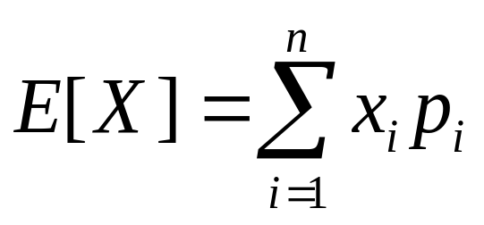
Sample mean
Expected value of X = E[X]
  “First moment” of X
  x_{i} = values measured
  p_{i} = Pr(X = x_{i}) = Pr(we measure x_{i})

Slide 30
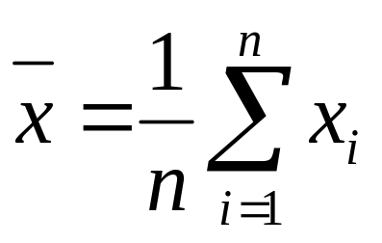
Sample mean
Without additional information, assume
  p_{i} = constant = 1/n
  n = number of measurements
Arithmetic mean
  Common “average”

Slide 31
Potential Problem with Means
Sample mean gives equal weight to all measurements
Outliers can have a large influence on the computed mean value
Distorts our intuition about the central tendency of the measured values

Slide 32
Potential Problem with Means
Mean
Mean

Slide 33
Median
Index of central tendency with
  ½ of the values larger, ½ smaller
Sort n measurements
If n is odd
  Median = middle value
  Else, median = mean of two middle values
Reduces skewing effect of outliers on the value of the index

Slide 34
Example
Measured values: 10, 20, 15, 18, 16
  Mean = 15.8
  Median = 16
Obtain one more measurement: 200
  Mean = 46.5
  Median = ½ (16 + 18) = 17
Median give more intuitive sense of central tendency

Slide 35
Potential Problem with Means
Median
Mean
Mean
Median

Slide 36
Mode
Value that occurs most often
May not exist
May not be unique
  E.g. “bi-modal” distribution
    Two values occur with same frequency

Slide 37
Mean, Median, or Mode?
Mean
  If the sum of all values is meaningful
  Incorporates all available information
Median
  Intuitive sense of central tendency with outliers
  What is “typical” of a set of values?
Mode
  When data can be grouped into distinct types, categories (categorical data)

Slide 38
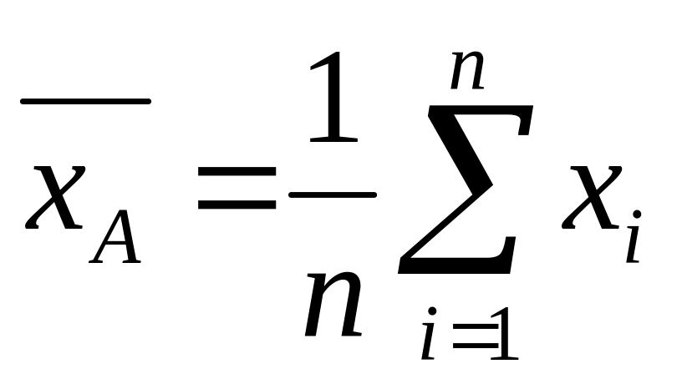
Arithmetic mean

Slide 39
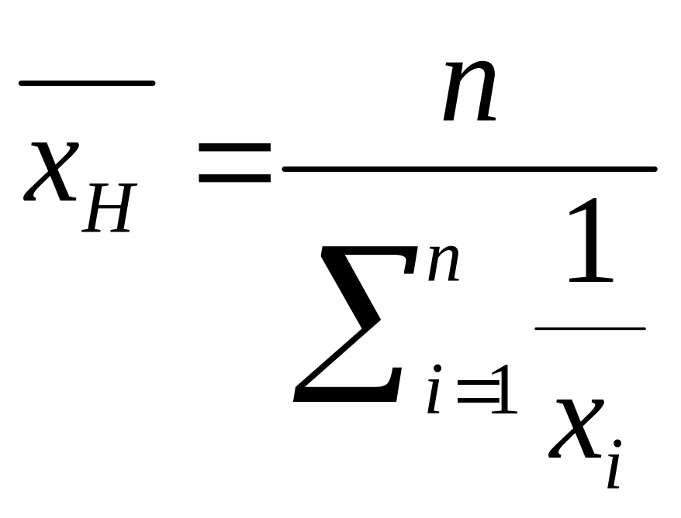
Harmonic mean

Slide 40
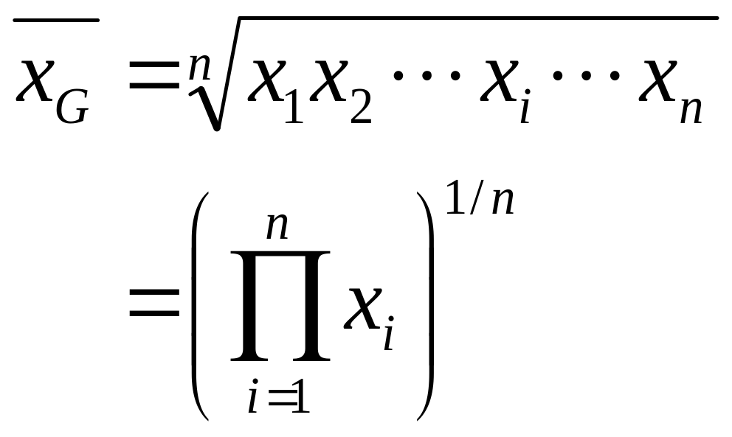
Geometric mean

Slide 41
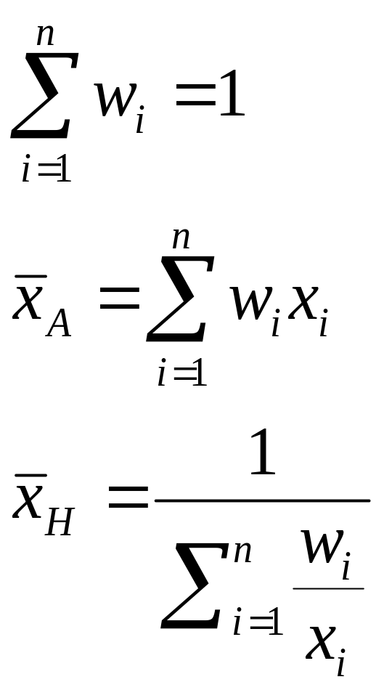
Weighted means
Standard definition of mean assumes all measurements are equally important
Instead, choose weights to represent relative importance of measurement i

Slide 42


Which is the right mean?
Arithmetic (AM)?
Harmonic (HM)?
Geometric (GM)?
WAM, WHM, WGM?
Which one should be used when?

Slide 43
Which mean to use?
Mean value must still conform to characteristics of a good performance metric
    Linear
    Reliable
    Repeatable
    Easy to use
    Consistent
    Independent
Best measure of performance still is execution time

Slide 44
What makes a good mean?
Time–based mean (e.g. seconds)
  Should be directly proportional to total weighted time
  If time doubles, mean value should double
Rate–based mean (e.g. operations/sec)
  Should be inversely proportional to total weighted time
  If time doubles, mean value should reduce by half
Which means satisfy these criteria?

Slide 45
Assumptions
Measured execution times of n benchmark programs
  T_{i}, i = 1, 2, …, n
Total work performed by each benchmark is constant
  F = # operations performed
  Relax this assumption later
Execution rate = M_{i} = F / T_{i}

Slide 46
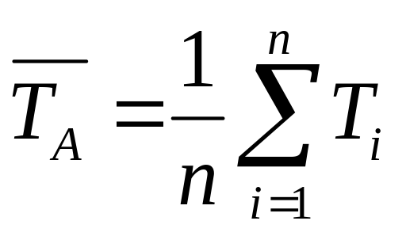
Arithmetic mean for times
Produces a mean value that is directly proportional to total time
→ Correct mean to summarize execution time

Slide 47
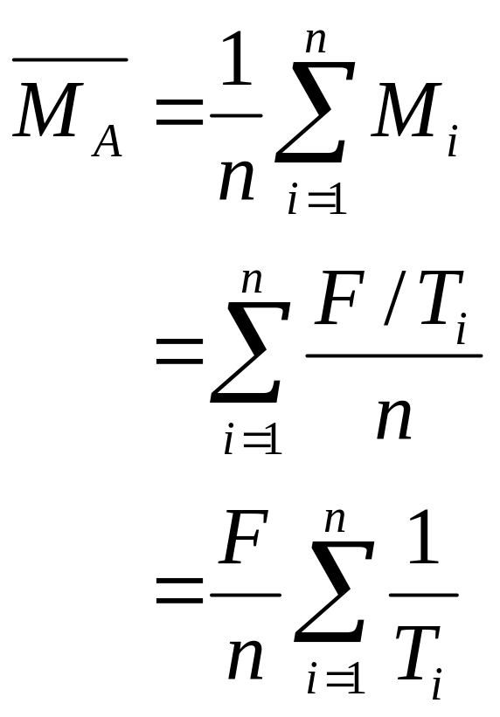
Arithmetic mean for rates
Produces a mean value that is proportional to sum of inverse of times
But we want inversely proportional to sum of times

Slide 48
Arithmetic mean for rates
Produces a mean value that is proportional to sum of inverse of times
But we want inversely proportional to sum of times
→ Arithmetic mean is NOT appropriate for summarizing rates

Slide 49
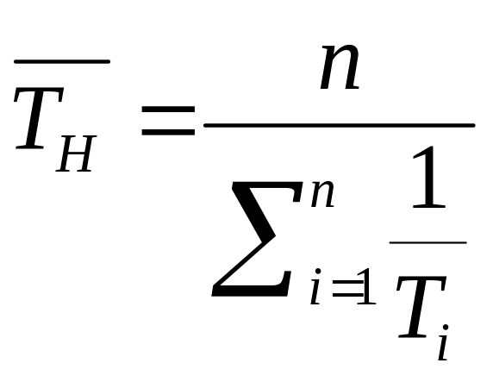
Harmonic mean for times
Not directly proportional to sum of times

Slide 50
Other Averages
E.g., drive 30 mph for first 10 miles, then 90 mph for next 10 miles, what is average speed?
Average speed = (30+90)/2 WRONG
Average speed = total distance / total time
= (20 / (10/30 + 10/90))
= 45 mph
When dealing with rates (mph) do not use arithmetic mean

Slide 51
Harmonic mean for times
Not directly proportional to sum of times
→ Harmonic mean is not appropriate for summarizing times

Slide 52
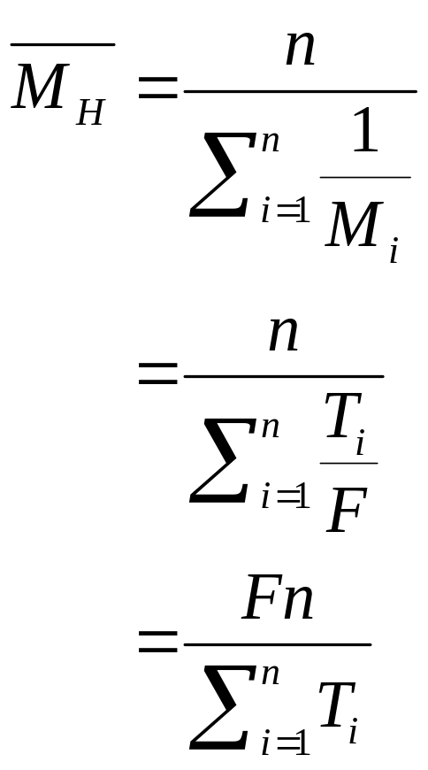
Harmonic mean for rates
Produces
  (total number of ops)
  ÷ (sum execution times)
Inversely proportional to total execution time
→ Harmonic mean is appropriate to summarize rates

Slide 53
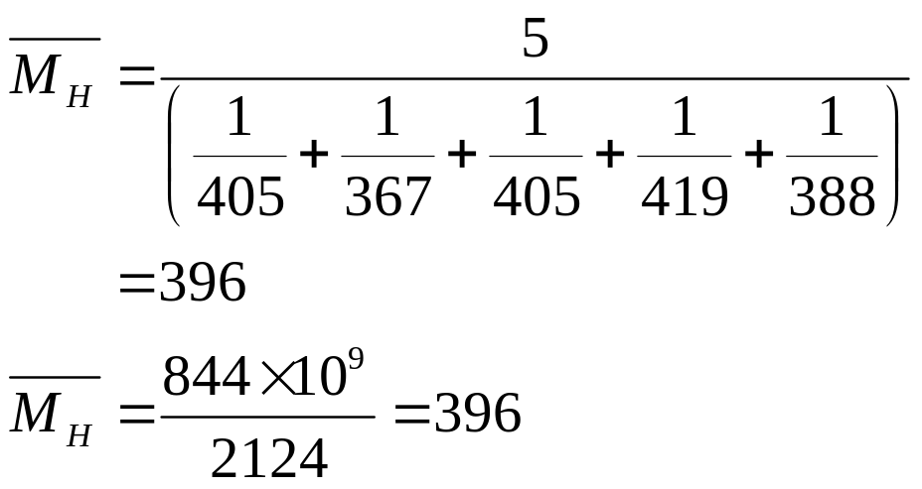
Harmonic mean for rates
Sec | 10⁹ FLOPs | MFLOPS
321 | 130 | 405
436 | 160 | 367
284 | 115 | 405
601 | 252 | 419
482 | 187 | 388

Slide 54
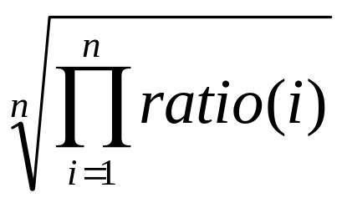
Geometric Mean
Use geometric mean for ratios
Geometric mean of ratios =
Independent of reference machine
In the example, GM wrt. machine a is 1, wrt. machine B is also 1
  Normalized with respect to either machine

Slide 55
Geometric mean
Correct mean for averaging normalized values, right?
Used to compute SPECmark
Good when averaging measurements with wide range of values, right?
Maintains consistent relationships when comparing normalized values
  Independent of basis used to normalize

Slide 56
Geometric mean with times
 | System 1 | System 2 | System 3
 | 417 | 244 | 134
 | 83 | 70 | 70
 | 66 | 153 | 135
 | 39,449 | 33,527 | 66,000
 | 772 | 368 | 369
Geo mean | 587 | 503 | 499
Rank | 3 | 2 | 1

Slide 57
Geometric mean normalized to System 1
 | System 1 | System 2 | System 3
 | 1.0 | 0.59 | 0.32
 | 1.0 | 0.84 | 0.85
 | 1.0 | 2.32 | 2.05
 | 1.0 | 0.85 | 1.67
 | 1.0 | 0.48 | 0.45
Geo mean | 1.0 | 0.86 | 0.84
Rank | 3 | 2 | 1

Slide 58
Geometric mean normalized to System 2
 | System 1 | System 2 | System 3
 | 1.71 | 1.0 | 0.55
 | 1.19 | 1.0 | 1.0
 | 0.43 | 1.0 | 0.88
 | 1.18 | 1.0 | 1.97
 | 2.10 | 1.0 | 1.0
Geo mean | 1.17 | 1.0 | 0.99
Rank | 3 | 2 | 1

Slide 59
Total execution times
 | System 1 | System 2 | System 3
 | 417 | 244 | 134
 | 83 | 70 | 70
 | 66 | 153 | 135
 | 39,449 | 33,527 | 66,000
 | 772 | 368 | 369
Total | 40,787 | 34,362 | 66,798
Arith mean | 8157 | 6872 | 13,342
Rank | 2 | 1 | 3

Slide 60
What’s going on here?!
 | System 1 | System 2 | System 3
Geo mean wrt 1 | 1.0 | 0.86 | 0.84
Rank | 3 | 2 | 1
Geo mean wrt 2 | 1.17 | 1.0 | 0.99
Rank | 3 | 2 | 1
Arith mean | 8157 | 6872 | 13,342
Rank | 2 | 1 | 3

Slide 61
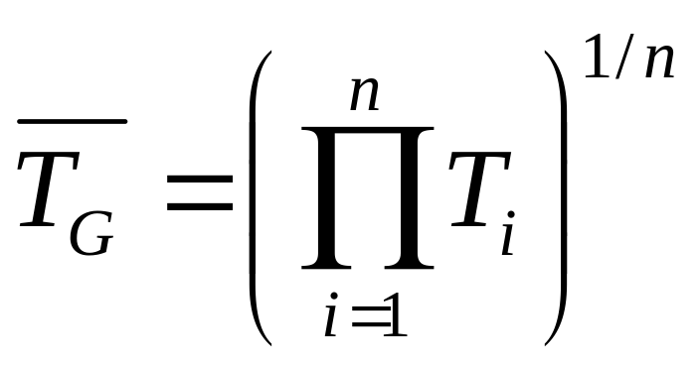
Geometric mean for times
Not directly proportional to sum of times

Slide 62
Geometric mean for times
Not directly proportional to sum of times
→ Geometric mean is not appropriate for summarizing times

Slide 63
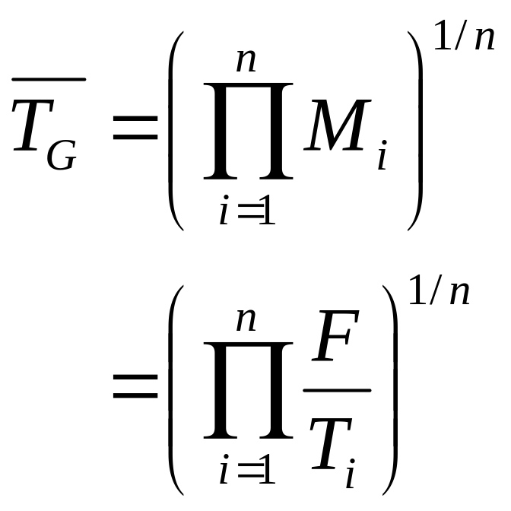
Geometric mean for rates
Not inversely proportional to sum of times

Slide 64
Geometric mean for rates
Not inversely proportional to sum of times
→ Geometric mean is not appropriate for summarizing rates

Slide 65
Summary of Means
Avoid means if possible
  Loses information
Arithmetic
  When sum of raw values has physical meaning
  Use for summarizing times (not rates)
Harmonic
  Use for summarizing rates (not times)
Geometric mean
  Not useful when time is best measure of perf

Slide 66
Geometric mean
Does provide consistent rankings
  Independent of basis for normalization
But can be consistently wrong!
Value can be computed
  But has no physical meaning

Slide 67
Normalization
Averaging normalized values doesn’t make sense mathematically
  Gives a number
  But the number has no physical meaning
First compute the mean
  Then normalize

Slide 68
AM? GM? HM? WAM? WHM? WGM? What are the Weights??????
Measure | Valid central tendency for summarized measure over the suite
IPC
CPI
Speedup
MIPS
MFLOPS
Cache hit rate
Cache misses per instruction
Branch misprediction rate per branch
Normalized execution time
Transactions per minute

Slide 69
The mean to be used to find aggregate measure over a benchmark suite from measures corresponding to individual benchmarks in the suite
Measure | Valid central tendency for summarized measure over the suite
IPC | W.A.M. weighted with cycles | W.H.M. weighted with I-count
CPI | W.A.M. weighted with I-count | W.H.M. weighted with cycles
Speedup | W.A.M. weighted with execution time ratios in improved system | W.H.M. weighted with execution time ratios in the baseline system
MIPS | W.A.M. weighted with time | W.H.M. weighted with I-count
MFLOPS | W.A.M. weighted with time | W.H.M. weighted with FLOP count
Cache hit rate | W.A.M. weighted with number of references to cache | W.H.M. weighted with number of hits
Cache misses per instruction | W.A.M. weighted with I-count | W.H.M weighted with number of misses
Branch misprediction rate per branch | W.A.M. weighted with branch counts | W.H.M. weighted with number of mispredictions
Normalized execution time | W.A.M. weighted with execution times in system considered as base | W.H.M. weighted with execution times in the system being evaluated
Transactions per minute | W.A.M. weighted with exec times | W.H.M. weighted with proportion of transactions for each benchmark
A/B | W.A.M. weighted with B’s | W.H.M. weighted with A’s

Slide 70
Conditions under which unweighted arithmetic and harmonic means are valid indicators of overall performance
 | To summarize measure over the suite
Measure | When is AM valid? | When is H.M. valid?
IPC | If equal cycles in each benchmark | If equal work (I-count) in each benchmark
CPI | If equal I-count in each benchmark | If equal cycles in each benchmark
Speedup | If equal execution times in each benchmark in the improved system | If equal execution times in each benchmark in the baseline system
MIPS | If equal times in each benchmark | If equal I-count in each benchmark
MFLOPS | If equal times in each benchmark | If equal FLOPS in each benchmark
Cache hit rate | If equal number of references to cache for each benchmark | If equal number of cache hits in each benchmark
Cache misses per instruction | If equal I-count in each benchmark | If equal number of misses in each benchmark
Branch misprediction rate per branch | If equal number of branches in each benchmark | If equal number of mispredictions in each benchmark
Normalized execution time | If equal execution times in each benchmark in the system considered as base | If equal execution times in each benchmark in the system being evaluated
Transactions per minute | If equal times in each benchmark | If equal number of transactions in each benchmark
A/B | If B’s are equal | If A’s are equal

